Slide 1

Graph Hardware is Coming! April 20, 2021
Dan McCreary
Distinguished Engineer
Advanced Technology Collaborative
Notes:
Hi – my name is Dan McCreary. I am a Distinguished Engineer working in the Advanced Technology Collaborative. I am leading the graph technologies initiative within the Advanced Technology Collaborative. Our goal is to build a collaborative community the use graph technology to lower the cost of healthcare and give Optum a competitive advantage in the marketplace.

Slide 2
Talk Description
Title: Graph Hardware Is Coming!
In this session we will show how current general-purpose CPU hardware fails to delivery high performance graph analytics. We will how that by doing a detailed analysis of the actual functionally needed by graph queries, we can redesign hardware that is optimized for fast graph traversal. We will also show how by combining graph and machine learning that an entire new generation of “sparse matrix” processing will move large enterprise graphs to an entire new level of performance.
After this session participants will:
Understand the limitations of today’s current hardware
Understand the needs of large graph analytics workloads
Understand how hardware can be redesigned for faster performance and lower power consumption

Slide 3
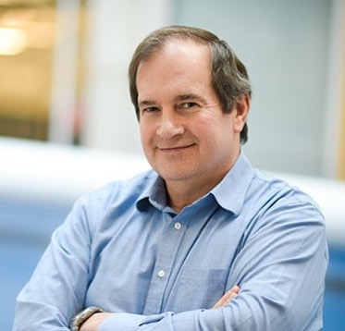
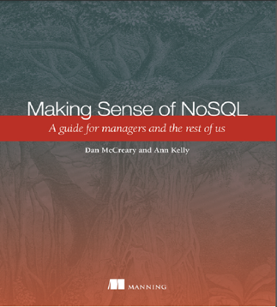
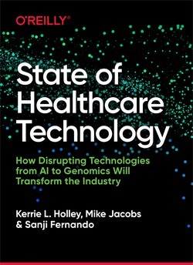
Hello, my name is
Dan
Distinguished Engineer in AI and Graph Technologies
Co-founder of "NoSQL Now!" conference
Co-author of "Making Sense of NoSQL" (w. Ann Kelly) and “State of Healthcare Technology”
20+ years of working with NoSQL
Background in solution architecture, knowledge representation for AI, data strategy, NLP, mentoring and curriculum design for technology solutions
STEM curriculum volunteer
Personal Mission: Help organizations objectively match business problems to emerging technology with storytelling
Notes:
My background is a solution architect. I have spent most of the last 20 years understanding how to objectively match business problems to the appropriate technologies. My focus has been on the fast-evolving area of NoSQL databases. I have also had a strong interest in AI, semantics, natural language process and search. I have been working on challenges problems in C360 and Benefit Search for over four years within Optum.

Slide 4
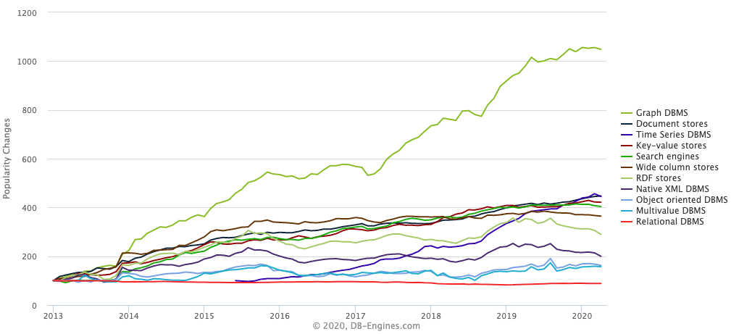
Graph Databases are HOT!
Graph Databases
https://db-engines.com/en/ranking_categories
Notes:
This chart shows the relative change in popularity of graph databases compared to other technologies according to DB Engines. DB Engines has web crawlers that regularly harvest an classify data related to databases. You can see that Graph Database popularity is the fasting growing database technology. This trend started in 2013 and it is continuing strong in 2018. Note that is is not absolute popularity. This is the change is popularity. Popularity also does not imply suitability. However, with these disclaimers aside you can clearly see a sustainable trend. Let’s see what other evidence we have about the rise of graph technologies.

Slide 5
The World is “Not Only SQL” (a.k.a. NoSQL)
Relational
Analytical (OLAP)
Key-Value
key
value
key
value
key
value
key
value
Column-Family
Graph
Document
See Chapter 1: https://www.manning.com/books/making-sense-of-nosql
5
Notes:
OK, now lets take a step back and take a more structure look at where these tools fit into our business processes at Optum.
There are six main database architecture patterns we use when we think of a business problem.
Relational or row-stores
Analytical or OLAP
Key-Value stores – one of the simplest but most extensible data architectures
Column-family stores
Graph stores
and Document stores
Graph is just one of these six. Graph stores are often most closely related to document stores. Both Graph and document stores have the ability for new data to be added to structures without needing to remodel the data. We call these systems schema-free or schema agnostic. They are a key driver for highly agile systems.
Your systems may often draw on two or more of these systems. Databases that support multiple data models are called multi-model databases. They prevent us from having to store the same data over in multiple systems for transactions, search and analytics. Multi-modal systems that integrate graph technologies are also an emerging trend.

Slide 6
Relational vs. Graph
Relational (row store)
Graph
ID
NAME
DATE
AMOUNT
Atomic unit of storage is a row of a table and data is appended to a table one row at a time
All columns within a table must have the same structure and no variations within a column are allowed
Table structures are fixed after design – all rows have the same structure
Relationship traversal is done via JOINs at runtime using log(N) search calculated at query time
It is difficult to distribute an RDBMS over a cluster of 100+ nodes since joins require in-memory comparisons
Atomic unit of storage are nodes and edges
Each node and edge may have independent properties that are determined at run time (schema agnostic)
Joins between nodes and edges are computed at load time and are stored as memory pointers
Relationship traversal is done using pointer hopping – each core can evaluate 2M hops per second
Distributed graph products are new but offer up to 100-fold increase in relationship traversal performance
Notes:
Now lets do a side-by-side comparison of both the traditional Relational row-store and compare some key facts. With a row store, the atomic unit of work is adding a single row at a time to a table. The key is that all the datatypes in each column must be the same. If there are dates in the third column and decimals in the fourth column all your data must conform to this standard. The table column structures and datatypes are fixed when you design your database. Once you have a million rows loaded into each table and 10,000 reports created it becomes challenging to modify the database.
Relational database also use the SQL language and they use join operations to dynamically calculate relationships each time the query is run. These calculations are based on binary search algorithms that run in log(N) time where N is the number of rows in each table. As the table grows the searches sale as the log of the number of rows.
Graph databases on the other hand allow you to add any number of nodes and and relationships into your graph database. Each node and relationship has it own properties but there are usually few overarching rules about what datatypes these structures can contain. Graph databases also used fixed memory pointers to store relationships between each node. As a result the queries over relationships are fast and there is no slow-down as the number of verticies gets bigger.

Slide 7
RDBMS to Graph Summary
Relational
Databases
1,000x
Single Node
Graph
GTEPS
Making a shift from Relational Databases to Single Node Graph gives us a 1,000x increase in relational traversal performance
GTEPS = Billion Traversed Edges Per Second

Slide 8
Serial vs. Parallel Graph Algorithms
Serial Graph Algorithms
Parallel Graph Algorithms
Task
Start
Task
Task
Task
End
Start
Task
End
Task
One task cannot begin before the prior task is complete
Task order is important
Serial algorithms work well on traditional CPUs
Many tasks can be done independently
Task order in not relevent
Tasks can usually be done faster on parallel hardware such as an FPGA

Slide 9
Distributed Graph
Each server has 1 TB RAM and 128 cores
Each core can traverse 2 million edges per second
256 million edges per second per server (1/4 GTEPS)
Replication
Automatic rebalancing when new servers added
Applications
Production Cluster
20 Servers
SLA, HA
Query
Aggregate Performance: 20 X 256M = 5.12 GTEPS
Under 100 millisecond response time for 10K users running singleton queries
99.999% uptime
High levels of service Availability
GTEPS = 1 Billion (Giga) Traversed Edges Per Second

Slide 10
Single Node Graph to Distributed Graph Summary
Relational
Database
Single Node
Graph
Distributed
Graph
Hardware
Graph
1,000x
100x
?
GTEPS
GTEPS
Moving from Single Node Graph to Distributed Graph gives us a 100x increase in relational traversal performance
Five orders-of-magnitude total speedup
What next?

Slide 11
Queryability vs Scale Out
Algorithmic
Richness
Enterprise
Knowledge
Graph
Hardware
Graph
Single Node
Graph
Data Hubs
Data Lake
Scale Out

Slide 12
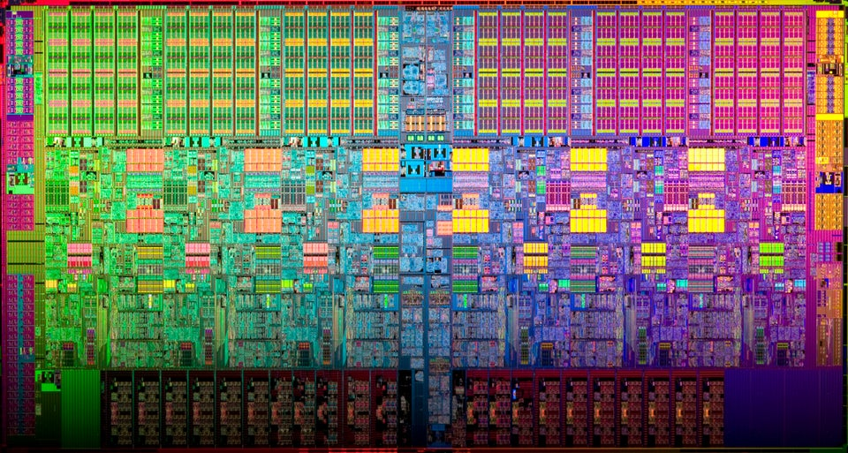
Are Current CPUs Optimized for Fast Graph Traversal?
The current Intel x86 instruction set has over 1,500 instructions
Graph pointer hoping needs around 100 instructions
A large percentage of circuits are dedicated to branch prediction which are no longer used
Memory subsystems focus on caching which will not be used
Only about 10% of the transistors are used – the others waste silicon area and power
Intel Xeon with over 1,500 instructions
https://en.wikipedia.org/wiki/Xeon
Notes:
https://www.reddit.com/r/pics/comments/67utku/this_nanoscale_photograph_of_an_intel_xeon/

Slide 13
Graph Traversal is Memory Pointer Hopping
Graph traversal can be reduced to a set of small pointer lookup operations (aka pointer hopping, pointer chasing)
The key is that they must scale in parallel
Our goal is to optimized the design of the instruction set and the memory access patterns to optimize graph traversal
We needed a new distributed graph architecture with many cores and faster memory access patterns

Slide 14
Example: Learning Embeddings Via Random Walk
Embedding: 200 32-bit integers
NLP technologies have shown us that we can create low-dimensional embeddings for every word by looking at the sequence of words in text.
Using Random Walk algorithms, we can create a similar sequence of items to create embeddings for primary vertices (Customer, Product etc.)
We can use these embeddings for 50 msec comparisons over 100M items if we do the calculations in parallel
Random Walks are very CPU intensive and require traversal of hundreds of millions of edges

Slide 15
Graph Embedding
Embedding
Customer Data
Or Any Subgraph
A data structure used to create fast similarity calculations
Usually stored as a fixed-length vector of scaler decimals
Optimized for fast parallel comparison

Slide 16
Compiled Programs versus Graph Applications
Compiled Programs
Graph
Traversal
Branch Prediction
Branches have
regular pattern
Branch outcome is data dependent (“Pointer hopping”)
Locality
Same or neighboring data likely used
Data is randomly distributed in RAM
Data Access
Same operation on neighboring data
Operations on scattered data

Slide 17
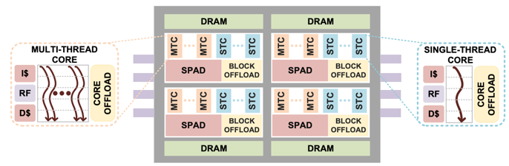
What If We Designed Our Chip Around Graph Traversal?
Deep analysis of what instructions and memory patterns are actually being used in graph database traversal
Focus on the smallest RISC instructions that will do the work
Create memory access design that will allow fast access without the need for elaborate and wasteful cache circuitry
Some algorithms show a 1,000x increase in performance
https://dmccreary.medium.com/intels-incredible-piuma-graph-analytics-hardware-a2e9c3daf8d8

Slide 18
Why Are Similarity Calculations Critical?
Similarity is at the foundation of recommendation engines
Recommendation engines power sites like:
Google – recommend a document
NetFlix™ – recommend a movie
Amazon - recommend a product
Pintrest™ – recommend an interest
Healthcare – recommend a care path
Recommendations must take into account many factors including recent data
To be useful, interactive web sites we set a goal of response times of under 200 milliseconds or less
Next Best Action
Recommendation
Similarity

Slide 19
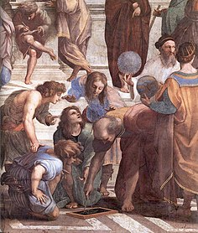
Euclidian Geometry
NEXT_TO
d = constant
Red=192
Green=0
Blue=0
When all points in a plane have equal spacing, we have “Euclidian” geometry
Euclidian geometry has properties that are ideal for “SIMD” architectures: single instruction, multiple data
Each item has uniform homogeneous data (red, green, blue values)
Detail from The School of Athens depicting the instruction of plane geometry
https://en.wikipedia.org/wiki/Euclidean_geometry

Slide 20
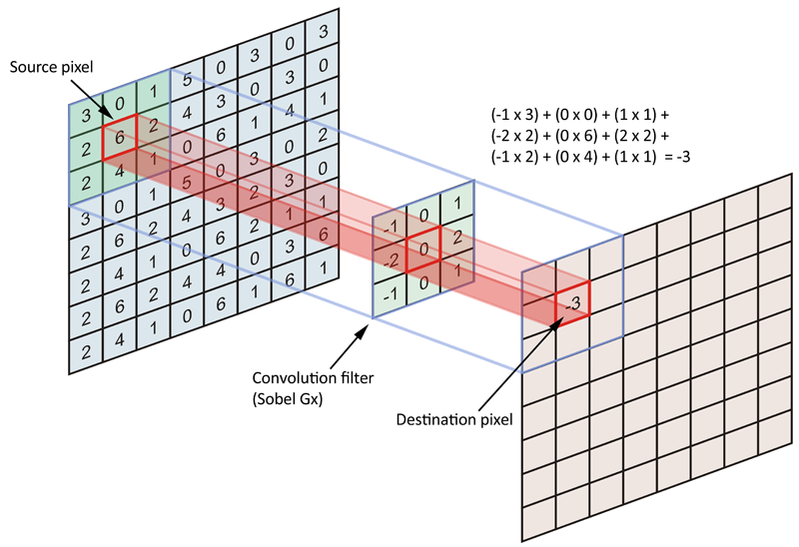
Insight through Convolutions in Neural Networks
Uniform operations on regions of the image
Input is an array of pixels
Output is an array of pixels
Transform is an array of pixels
Unit of work is matrix multiplication that can be executed in parallel

Slide 21
Non-Euclidian Geometry
Every vertex and in a graph holds connected knowledge
Data is heterogeneous – every node has a different type
The relationship types are heterogeneous
Insight is gained through graph traversal
Similar to a SQL query, but our focus is on edge-traversal
We need high core counts and fast memory to speed parallel traversal

Slide 22
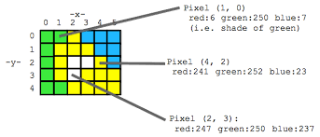
Dense (Image) to Sparse (Clinical) Processing
Dense Matrix
Sparse Matrix
ICD-10 Diagnosis Codes (100K of them…)
 | D64.9 | F32.9 | R53.83 | I50.9 | R50.9
Jane Doe | 0 | 1 | 0 | 0 | 0
Fred Smith | 0 | 0 | 1 | 0 | 0
Susan Brown | 0 | 0 | 0 | 0 | 1
Alex Johnson | 0 | 0 | 0 | 1 | 0
For an image matrix, almost very point in the array has non-zero values for the RGB or grayscale intensity.
99.999% of the values are zero
Sparse Matrix problems are ideal for graph representation.
Notes:
AI has had many advances in the areas of image, and speech recognition. These processes represent their data in the form of a matrix of values, where almost all the values of a cell are non-zero. We call this a dense matrix representation. However, in healthcare we can’t use these same dense representations. If we put all our patients in a matrix with one column for each ICD-10 diagnostic code – and there are over 100K codes – we would then be able to turn a cell to 1 only if that patient has that diagnosis. Since a patient might only have a few diagnosis codes, 99.999 percent of these values will be zeros. We call this a sparse matrix. GPUs are very inefficient at processing this data since the information density is very low. Instead we need graph representation of our patients.

Slide 23
Primary Driving Use Case: Real-Time Patient Similarity
Sample Patient Populations (100s of millions)
Which patients are the most like this patient?
New Patient
in Emergency
Room
Given a new patient that arrives a clinical setting, how can we quickly find the most similar patients?
What care plans had the best outcomes?
Return the 100 most similar patients in under 1/10th of a second
Field of study: Clinical Decision Support

Slide 24
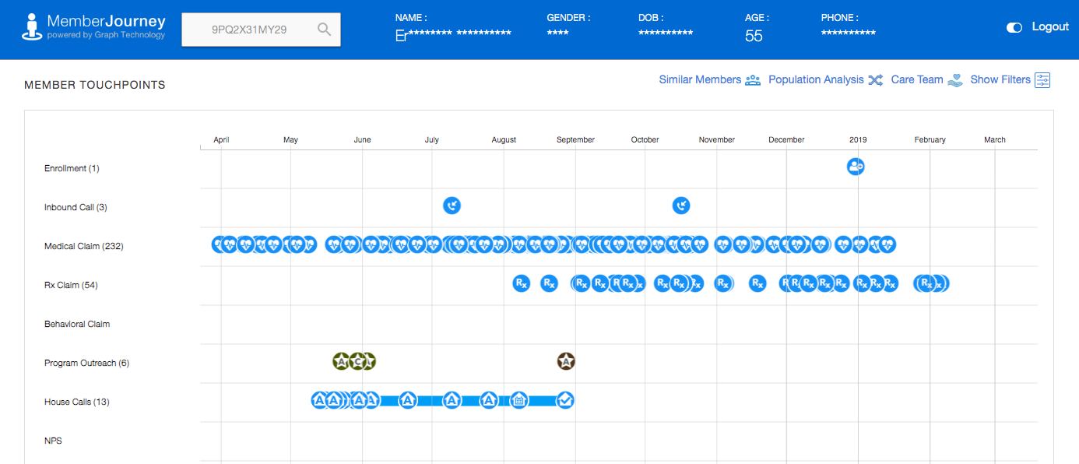
100 millisecond screen rendering with no JOINs

Slide 25
Similarity Score – A scaled measure of “alikeness” for a context
Care Plan 1
95% effective
.43
Care Plan 2
82% effective
.92
Top 100
Care Plan 4
75% effective
.1
A single scaled dimension of comparison for a given setting or context
Comparing a patient to itself would have a similarity score of 1.0
Patients that have few common characteristics would have a score of 0.1

Slide 26
Graph Representation of Patients – Includes Structure
Sample Patient Population (250M)
Target Patient
Similarity score = .5
Similarity score = .9
Similarity score = .8
How can I quickly compare these graphs and find the most similar patients?
Notes:
Finally, lets mention the role of intelligent agents to this process. Agents will be able to access all of these graphs to perform specific tasks for our community of users. Agents will be able to quickly generate specific graph queries that gather just the information they need to perform a task.

Slide 27
From Graph to Vector Space
Feature Engineering
Target Patient Numeric Vector
Gender
Age
CohortCode1
CohortCode2
Condition1
Condition2
Disease1
Disease2
Drug1
Drug2
Gene1
Gene2
1
10
5
8
14
3
6
57
34
15
5
66
Target Patient Graph
We need to convert the graph representation into a vector of scalers
How do we represent counts?
How can we automate the process of finding both the relevent properties and structure in our graph?

Slide 28
“Patients Like Me”
Target Patient Graph
Cohort Sample Population Vectors
Key Features
Gender
Age
CohortCode1
CohortCode2
Condition1
Condition2
Disease1
Disease2
Drug1
Drug2
Gene1
Gene2
Gender
Age
CohortCode1
CohortCode2
Condition1
Condition2
Disease1
Disease2
Drug1
Drug2
Gene1
Gene2
Gender
Age
CohortCode1
CohortCode2
Condition1
Condition2
Disease1
Disease2
Drug1
Drug2
Gene1
Gene2
Gender
Age
CohortCode1
CohortCode2
Condition1
Condition2
Disease1
Disease2
Drug1
Drug2
Gene1
Gene2
Cosine similarity
Demographics
Conditions
Extract
Genes
IoT
Similarity Score:
.80
.89
.92
Graph Similarity algorithms allow graph databases to quickly compare current items with many other items
For any given patient, we can use a fast, in-memory similarity algorithm to compare the key features of any patient to a larger population
Cohort codes can be pre-calculated to quickly narrow the sample population to a smaller group
This calculation is considered an “embarrassingly parallel” query and could be accelerated by adding more nodes to a cluster
Specialized graph hardware is coming (FPGA)

Slide 29
Driving Use Case: Real-Time Patient Similarity
Sample Patient Populations (100s of millions)
Which patients are the most like this patient?
Patient Embedding (200 element vector)
100 most similar patients returned
in 100 milliseconds
New Patient
in ER
Given a new patient that arrives a clinical setting, how can we quickly find the most similar patients?
Assumption: we have 10M “clean” clinical records of our population of 235 million members
No overnight batch jobs!

Slide 30
Dense (Image) to Sparse (Clinical) Processing
Dense Matrix
Sparse Matrix
ICD-10 Diagnosis Codes (100K of them…)
 | D64.9 | F32.9 | R53.83 | I50.9 | R50.9
Jane Doe | 0 | 1 | 0 | 0 | 0
Fred Smith | 0 | 0 | 1 | 0 | 0
Susan Brown | 0 | 0 | 0 | 0 | 1
Alex Johnson | 0 | 0 | 0 | 1 | 0
For an image matrix, almost very point in the array has non-zero values for the RGB or grayscale intensity.
99.999% of the values are zero
Sparse Matrix problems are ideal for graph representation.
Notes:
AI has had many advances in the areas of image, and speech recognition. These processes represent their data in the form of a matrix of values, where almost all the values of a cell are non-zero. We call this a dense matrix representation. However, in healthcare we can’t use these same dense representations. If we put all our patients in a matrix with one column for each ICD-10 diagnostic code – and there are over 100K codes – we would then be able to turn a cell to 1 only if that patient has that diagnosis. Since a patient might only have a few diagnosis codes, 99.999 percent of these values will be zeros. We call this a sparse matrix. GPUs are very inefficient at processing this data since the information density is very low. Instead we need graph representation of our patients.

Slide 31
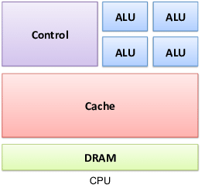
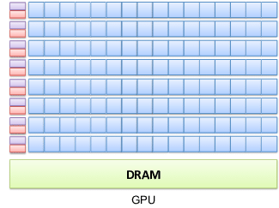
GPUs and SIMD are Ideal for “Euclidian” Geometry Problems
CPU
GPU
Large number of instructions
X86 has over 1,500 instructions
GPUs have a single instruction that manipulates uniform data (SIMD)
All threads execute the exact same instruction

Slide 32
Sample Graph Algorithms
Dependencies
Failure chains
Order of operations
Clustering
Finding related items
Friends, fraud networks
Louvain centrality
Similarity
Similar paths and patterns
Cosine similarity
API
Server
Auth
Data
Matching/Categorizing
Look for and tag specific patterns
Flow/Cost
Optimize costs based on routing
Path optimization
Centrality/Search
Which nodes are the most connected or relevant?
Notes:
Dan

Slide 33
Knowledge Triangle
Knowledge Patterns Relationships
The Knowledge Triangle (aka “DIKW” pyramid)
Diagram for representing the relationships between data, information, knowledge
Too often we focus on “Big Data” and not enough on connected knowledge and transferrable knowledge
Graphs are connected information concepts
Wisdom is reusable across multiple context
Can we capture knowledge in a form that can be reused across multiple domains?
Information - Concepts
Data - Binary, Codes, Data Lakes
https://en.wikipedia.org/wiki/DIKW_pyramid
Notes:
Now lets take a look into some of the reasons that organizations are moving toward knowledge graphs as ways to connect and reuse data. The structure we used to describe this system is called the Knowledge Triangle or sometimes the DIKW Pyramid. It is a triangle with Data at the bottom, Information at one level up, connected Knowledge (in the form of a graph) at the third level and Wisdom at the top.
In most systems, Data comes from external sources the form if low-level binary and numeric codes. For example this might be a table-by-table dump from a RDBMS system into a set of CSV files. However, the metadata that describes these codes is often not transmitted with the data. So it is difficult to figure out what the codes mean. At the Data level it is expensive and time consuming to find the meaning of data. We call this semantically poor data.
Some information might be stored at a higher level – we call this the Information level. At this level we clearly identify the nouns in the data. We find the people, places and things. But these things may not be connected together.
JSON and XML files are good choices to transmit information because they send labels with the data.
The next higher level is the Knowledge level. Knowledge is Information that is put in the right context – it is connected to other concepts. The Knowledge level allows us to focus on large patterns that stretch across multiple domains. We can move between Providers, Claims, Services and Members by doing queries over our graph.
The Wisdom is the layer most strongly associated with AI. When we think of going to the top of the mountain and we ask the Gurus for advice, we are asking them to apply their knowledge to our specific problem. We are asking them to transfer knowledge to our context.

Slide 34
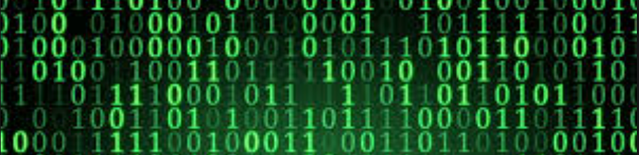
From Raw Data to Connected Knowledge
Knowledge can be reused across multiple context
Reusable To New Problems
Connections
De-duplicated
Knowledge
Graph
Consistent
Continuous
Enrichment
Tagged Text
Concepts
Validity
Semantics
Defintions
Searchable
Information
Data
Lake
Raw data dumped from a database, log files or documents
Notes:
This picture follows this same knowledge triangle pattern. However, we want to invoke the idea of raw binary Data Lake at the bottom with binary symbols that have little meaning without context.
The second layer is where we identify the nouns in our documents for data. We look for people, places and things in the byte stream. This is where we can understand isolated data – know the types, the definitions of the types and be able to validate if the 1s and 0s make sense within a narrow context. At this layer we are bringing together data and the metadata that describes that data. We are also checking the format of our data and making it consistent.
The third layer is where we start to tie our Nouns together in a graph. It is where we build relationship links between things. It is where we might look for duplicated data (Master Data Management), where we check for consistency and we verify the patterns of connections are consistent. The graph layer is where we can perform complex graph analytics algorithms.
The highest level is where we restructure our graph so that it comes in sub-graphs that are reusable across multiple applications. We can provide consistent APIs that pull data in consistent ways and these interfaces are reusable across many domains.
Central to this pyramid is the concept of continuous enrichment cycles. As we discover new things at a higher level, we sometimes provide feedback to lower levels.

Slide 35
Data Lakes Today
100s of Data Scientists
100s of R and Python Libraries
80% of effort is “Data Engineering”
Little code reuse
20% is real Data Science
Data Access Code
Data Lake
No metadata, no semantic layer, no indexing, no search, no ACID transactions

Slide 36


From Data Scientist to Knowledge Scientist
Knowledge
Graph
Fast Path with Feedback
Insights
70% of
your time
Information
Slow Path
Data
Data Engineering

Slide 37
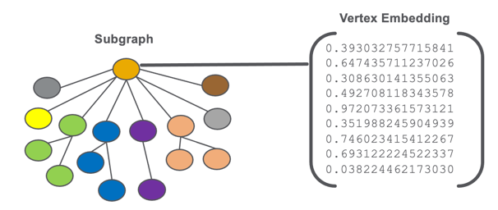
Subgraph and Vertex Embedding
Embeddings consider not just the attributes of a vertex, but the context of the vertex in a graph
Embeddings are learned representations of the knowledge in an enterprise knowledge graph (EKG)
The larger the graph, the more precise the embedding encodes information about the role of that vertex in the community of all other vertices of similar type
You can ”do math” on customers
add, subtract
average
Understanding Graph Embeddings:
https://dmccreary.medium.com/understanding-graph-embeddings-79342921a97

Slide 38
Product Recommendation
Customer Data
Customer Embedding
Product
Taxonomy
Demographics
Products
NPS, LTV
Region
Psychographics
C1
C2
C3
C4
Product Categories
Prior Purchases
Web Logs
P1
P2
P3
P4
P5
P6
P7
P8
Products
Returns
Searches
Complaints
Product Embedding
Given a context, what similar customers buy what similar products?
NPS – Net promoter score
LTV - Lifetime value of a customer

Slide 39

Three Eras of Computing
1) Procedural Era
Data
Programs
Answers
Procedural Code (Rules)
Explanations (Why)
2) Machine Learning Era
Data
Machine
Learning
Rules (10M weights)
Answers
3) Graph Era
Data
Knowledge
Answers
Machine
Learning
Explanations (Why)

Slide 40
Summary
Many enterprise-scale knowledge graphs today are limited by:
Lack of distributed graph databases
Using CPUs that were not designed for fast pointer hopping
Using memory designs that are not suited for graph traversal
By taking a Systems Thinking approach we can
Gain a 1,000x improvement over relational database JOINs
Gain a 100x improvement using distributed graphs
Gain another 1,000x improvement using custom graph hardware
Machine learning when combined with graph hardware will enable explainable predictions in trillion vertex scale graphs

Slide 41



Dan.McCreary@optum.com
https://dmccreary.medium.com
https://www.linkedin.com/in/danmccreary
@dmccreary

